Slide 1
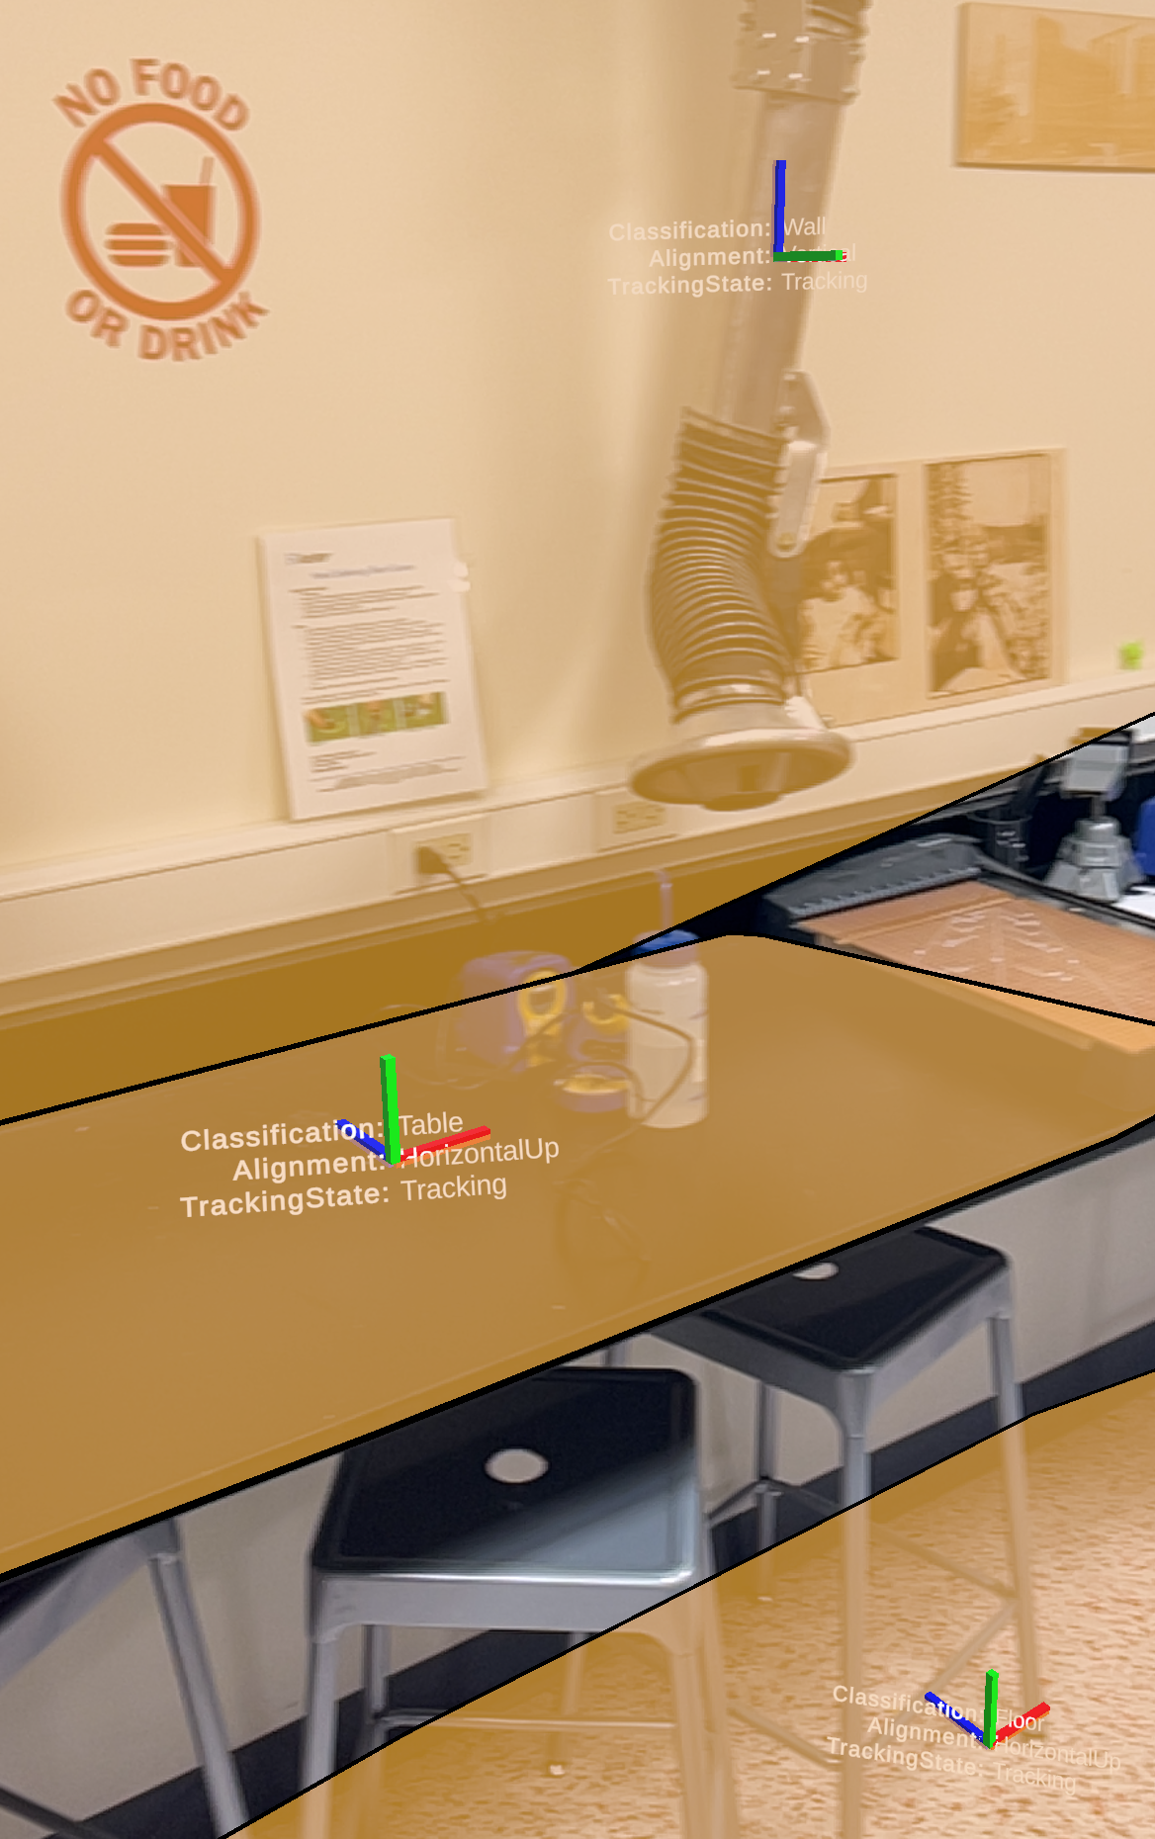
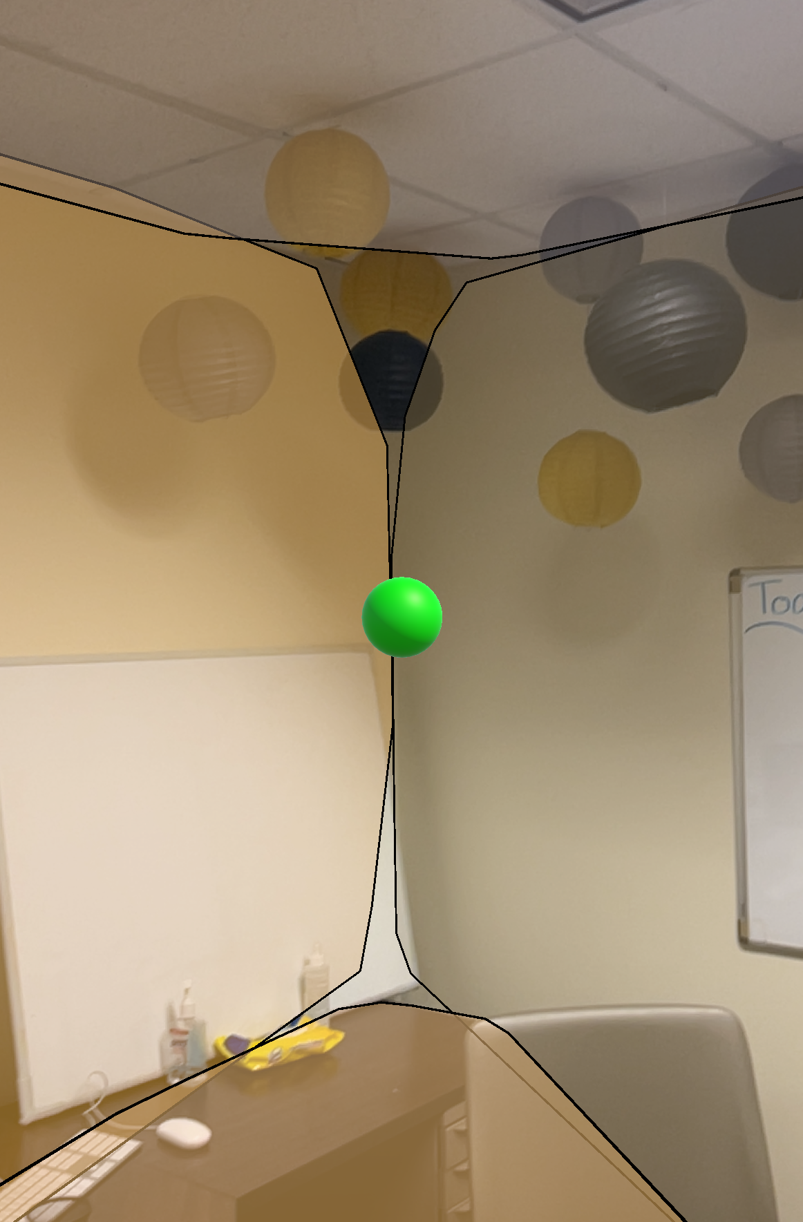
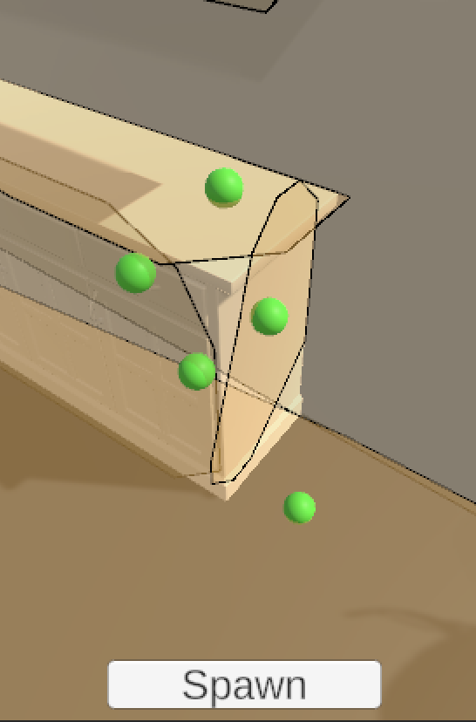
Developing and Teaching AR Graphics in Unity Aidan Moran¹ and Mitja Hmeljak*¹ Dept. of Computer Science, Indiana University, Bloomington, IN USA *corresponding author: mitja@iu.edu
13
While Unity and other virtual environments are great tools for teaching computer graphics, certain limitations are still present.
Typical input devices, such as mouse and keyboard or touchscreens, are limited to 2D input.
It can be difficult to keep tracks of object and their interactions, especially lights.
Using AR or XR can remedy this by allowing the user to use their intuitive understanding of motion and object interactions in the real world to better understand digital graphics.
Demos
6 Demos showcasing the basic functionality of AR Foundation,
integrating virtual graphics to the real environment, and
receiving real word data and information on the device
Surface Detection
Collision Detection
In object/In room detection
Total acceleration, linear acceleration, and gravitational
acceleration input
Light estimation
These demos were used to create a series of guides to teach
students the basics of AR development and AR graphics,
but also serve as examples as to what can be done with
AR systems in Unity.
Guides
In total, we produced 3 guides for students to follow to
introduce them to AR Foundation and digital graphics.
Guide one teaches how to install and test AR Foundation
Guide two teaches simple surface detection and how to visually represent surface meshes in the digital world and mixed into the real world camera input
Guide three teaches how to implement simple object collision with the detected surfaces, based on a distance test with the plane the surface exists on, was well as an operation that takes a 3D point of an object and a 2D mesh, compresses them into the same coordinate space, and performs a dot product to find if the object exists within the bounds of the mesh.
These guides not only teach AR basics, but also Unity basics, as they assume the student
will have no Unity or 3D graphics experience as they begin. This includes:
Installing packages
Asset management
Creating object prefabs
Basics of the Unity Hierarchy
Manipulating object data with the inspector
Basic use of the editor/game windows
Basic scripting
Construction of simple UIs
The final guide ends by illustrating a few shortcomings of the “discrete” collision detection we
created, and sets the student up with a challenge to improve upon it by creating a
continuous collision system.
Overall, AR introduces several new ways to help students understand 3D graphics and navigating digital 3D space.There’s still several features of AR Foundation worth exploring for an educational environment. These include :
Point clouds
Anchors
2D Image tracking
Ray casting
Environment Probes
There also exists the opportunity to take a preexisting graphics curriculum or project and rebuild it using AR, allowing for students to navigate their projects with a more intuitive, real word system.
There could be more done on the virtual side of these systems to better take advantage of the benefits a real word canvas gives us, as oppose to forcing a digital demonstration into an AR application, which would only complicate matters rather than make them more intuitive to learn.
Our goal is to build a demo demonstrating the capabilities of an AR environment, graphics pipeline functionality provided by AR Foundation for interactions between the AR and real world , as well as a series of guides for students to follow to teach AR graphics.
In room detection showing the 3D cursor is within the bounds of a room.
In room detection showing the 3D cursor is within the bounds of a room.
[1] Unity-Technologies. “AR Foundation Documentation.” Docs.unity3d.com, docs.unity3d.com/Packages/com.unity.xr.arfoundation@6.0/manual/index.html.
[2] Unity-Technologies. “Unity Documentation.” Docs.unity.com, docs.unity.com/. Version 2022.3 .
[3] Unity-Technologies. “GitHub - Unity-Technologies/Arfoundation-Samples: Example Content for Unity Projects Based on AR Foundation.” GitHub, 2018, github.com/Unity-Technologies/arfoundation-samples/. Accessed 11 Dec. 2024.
We used Unity’s AR Foundation package to develop a series of demos demonstrating how to receive data from the real world, as well as how to represent virtual data as an overlay to the real world and camera feed. [1][3]
As a part of AR Foundation, we received data from Apple’s AR Kit and various sensors embedded in to an iPhone to receive data such as light estimation and accelerator data. [2]
Part of our demos were based on the series of demos provided by Unity openly on GitHub, but refined to be easier to understand and follow by a student who may have no graphics or Unity experience to begin with. [3]
Thank you to Sabrina Marin and Bhumika Sati, who worked in on a parallel Unity lab as part of CEWIT/REUW independent study and followed along with the guides we made to ensure they were clear and easy to follow.
Also thank you to The TAs of B481/B581, Abhishek Ingle and Jack Morgenstern, who also followed the guides and made numerous recommendations to help them better fit a classroom setting.
We acknowledge this project, and many others, would have gotten stuck many times if not for the endless code snippets and guides created by the open source code and Unity communities.
The product of following the guides, showing thrown balls colliding with multiple surfaces.
Computer Graphics Courses at Indiana University

